Slide 1



DEPARTMENT OF ARTIFICIAL INTELLIGENCE & DATA SCIENCE
FINAL REVIEW
TEAM MEMBERS:
KAVIN K V (927621BAD021)
SHARAN ADHITHYA S (927621BAD047)
DINESH S (927621BAD011)
GUIDED BY:
Mrs. P. VIDHYA
Assistant Professor
Department of AI

Slide 2
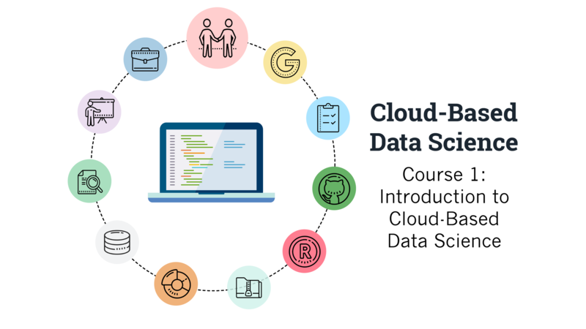
A Comprehensive Guide to Global Tourism and Cultural navigation

Slide 3
ABSTRACT
Identification of the plant diseases is the key to preventing the losses in the yield and quantity of the agricultural product. The studies of the plant diseases mean the studies of visually observable patterns seen on the plant. Health monitoring and disease detection on plant is very critical for sustainable agriculture. It is very difficult to monitor the plant diseases manually. It requires tremendous amount of work, expertize in the plant diseases, and also require the excessive processing time. Hence, image processing is used for the detection of plant diseases. Disease detection involves the steps like image acquisition, image pre-processing, image segmentation, feature extraction and classification.

Slide 4
INTRODUCTION
In today's globalized world, tourism has become an integral part of human experience, offering opportunities for cultural exchange, economic growth, and personal enrichment.
However, navigating the complexities of global tourism presents numerous challenges for both travelers and destinations alike.
Offer detailed information about tourist attractions, historical sites, accommodations, restaurants, transportation options, local events.
Provide content and support in multiple languages to cater to the diverse needs of travelers from different regions.

Slide 5
OBJECTIVES
A tourism guide system project aims to provide comprehensive information and assistance to travelers visiting a particular destination.
For Accessing information and services, ensuring that travelers can navigate the system effortlessly.
From cultural misunderstandings and environmental degradation to overtourism and economic exploitation.
The tourism industry faces a myriad of issues that need to be addressed.

Slide 6
PROBLEM STATEMENT
Now a days tourism is booming globally and online tourist guide is one of the important factors which promote and assist tourism in many ways so intelligent tourist guide is one of the main needs in the modern day tourism.
The problem lies in the lack of comprehensive and culturally sensitive guidance available to travelers, as well as the absence of sustainable practices and responsible tourism initiatives within the industry.

Slide 7
LITERATURE SURVEY
S.No | Paper Title | Author Name | Methods
1 | An Overview of Tour-Guide Training Literature in Türkiye | Aslan & Büyükkuru; Çokişler; Eser; Topsakal; Çokişler | tour guiding, training
2 | Survey on context-aware tour guide systems | Hamed Vahdat-Nejad , Hossein Khosravi-Mahmouei , Mohammad Ghanei-Ostad, Azam Ramazani | it fulfil the smartness of the infrastructure to provide intelligent personalised services
3 | Intelligent mobile tourist guide | Smirnov, A., Kashevnik, A., Balandin, S.I | Next Generation Wired/Wireless Advanced Networking
4 | A location aware mobile tourist guide | Ten Hagen, K., Modsching, M., Kramer, R | selecting and interpreting sights and services by context matching
5 | Tourism and mobile technology | Brown, B., Chalmers, M | Automatic construction of travel itineraries using social breadcrumbs

Slide 8
LITERATURE SURVEY
6 | Tourism and mobile technology | Brown, B., Chalmers, M | Automatic construction of travel itineraries using social breadcrumbs
7 | Context-aware recommendations in the mobile tourist application COMPASS | Van Setten, M., Pokraev, S., Koolwaaij, J | A system for mining interesting tourist locations and travel sequences from public geo-tagged photos
8 | Smart tourism destinations | Buhalis, D., Amaranggana | Information and communication technologies in tourism
9 | Research Design of Intelligent Tourist Guide System and Development | Kaijian Huang1, a and Junwu Zhu | Intelligent Tourist Guide System; Shortest Path Algorithm; Android
10 | A Model for Intelligent Tourism Guide System | H.H. Owaied, H.A. Farhan, N. Al-Hawamdeh | system can provide the relevant service of the spot more accurately for the visitors
11 | A systematic literature review for the tourist trip design problem: Extensions, solution techniques and future research lines | Jos´e Ruiz-Meza, Jairo R. Montoya-Torres | the trend of personalized tourism, which includes the management of itineraries by the tourist

Slide 9
LITERATURE SURVEY
12 | A Systematic Literature Review of Tour Guide Performance | ` | To be related to tourist satisfaction, tourist experience, behavior in the destination and the desire to revisit
13 | Tour Guide Performances, Tourist Satisfaction And Behavioural Intentions | Syakier, W. A., & Hanafiah, M. H. | A Study On Tours In Kuala Lumpur City Centre. Journal of Quality Assurance in Hospitality and Tourism
14 | Tour guides’ performance and tourists’ immersion | Hansen, A. H., & Mossberg, L | facilitating consumer immersion by performing a guide plus role. Scandinavian Journal of Hospitality and Tourism
15 | Virtual Tourist Guide | Shila Jawale , Sakshi Jadhav, Priyanka Jaybhaye , Nikita Sonavale | Virtual Tour, Android Based Guide Application, Gmap
16 | Virtual Reality Based Virtual Tour of College Using Unity 3D | Chaisoong, U., & Tirakoat, S | The proposed system virtual tour of college specifically on Unity3D which provides virtual view of college infrastructure

Slide 10
EXISITNG SYSTEM
Travel Agencies: it offers personalized trip planning services and curated tour packages, while convenient, these services may not always prioritize cultural immersion.
Online Forums and Social Media: Platforms like Reddit, TripAdvisor forums, and Facebook travel groups allow travelers to seek advice, share experiences, and connect with fellow enthusiasts.
Cultural and Environmental Organizations: it may offer educational resources and initiatives to promote responsible tourism and cultural preservation.

Slide 11
PROPOSED SYSTEM
Users can create accounts or log in using social media credentials.
Users can search for destinations, attractions, accommodations, and activities based on various criteria such as location, category, ratings, and reviews.
Personalized itinerary planning based on user preferences, interests, budget, and available time.
Users can provide feedback, report issues, or seek assistance through the website.

Slide 12
METHODOLOGY
Events and Packages: Calendar layout with color-coded events for easy identification. Integration with other scheduling tools for event reminders.
Member Services: User-friendly registration form with clear instructions and required fields.
User Query Support: Assist users with account registration, login issues, and password resets.

Slide 13
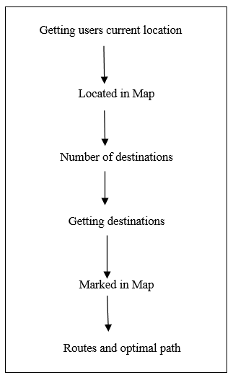
WORK FLOW

Slide 14
SOFTWARE REQUIREMENTS
Web Browser or Mobile Application
Windows 7 or higher
Android Development Toolkit(ADT)
Visual Studio 2010
SQL Server 2008
Android 5.0 or higher

Slide 15
PROGRESS OF THE WORK
Content Compilation: Curated and compiled diverse cultural information, including historical landmarks, traditions, and local customs, from global sources and community contributions.
Platform Development: Designed and developed user-friendly web and mobile interfaces, integrating interactive maps, cultural databases, and personalized recommendation algorithms for seamless navigation.
Quality Assurance: Conducted rigorous testing and validation processes to ensure accuracy, reliability, and cultural authenticity of the guide's content and technical features.

Slide 16
PROGRESS OF THE WORK
User Feedback Integration: Incorporated user feedback and suggestions through iterative design refinements, enhancing the guide's usability and relevance for diverse travelers.
Community Engagement: Fostered community engagement through user forums, feedback channels, and collaborative content creation initiatives, promoting inclusivity and cultural exchange.
Continuous Improvement: Monitored user engagement metrics and iterated on the guide's content, features, and user experience to enhance its effectiveness and relevance over time.

Slide 17
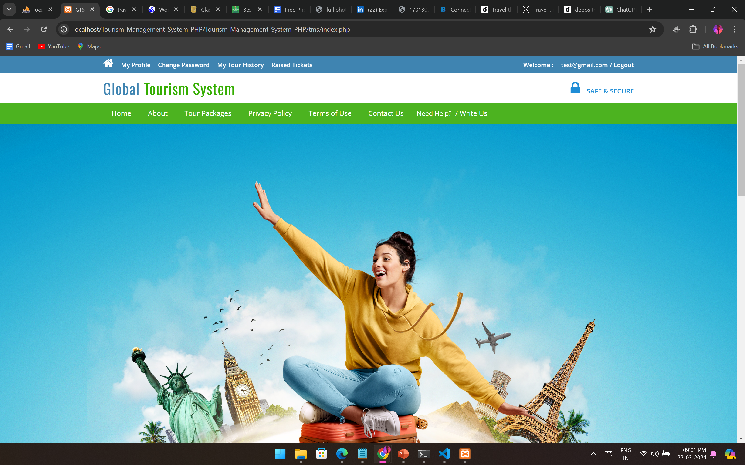
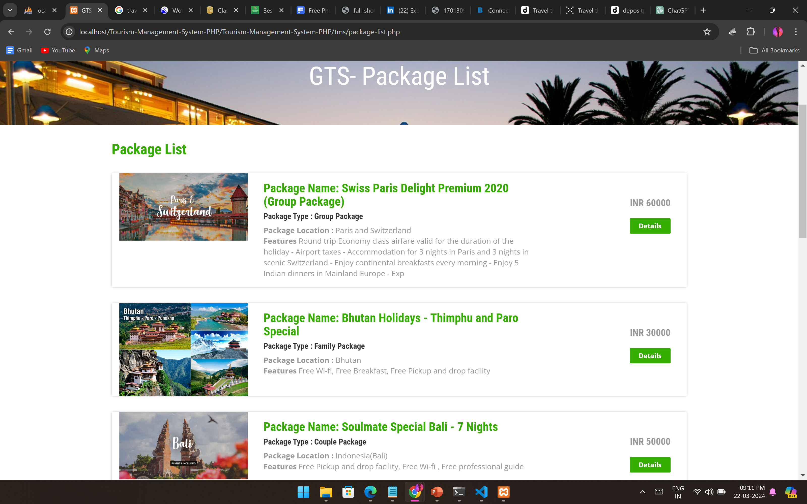
IMPLEMENTATION

Slide 18
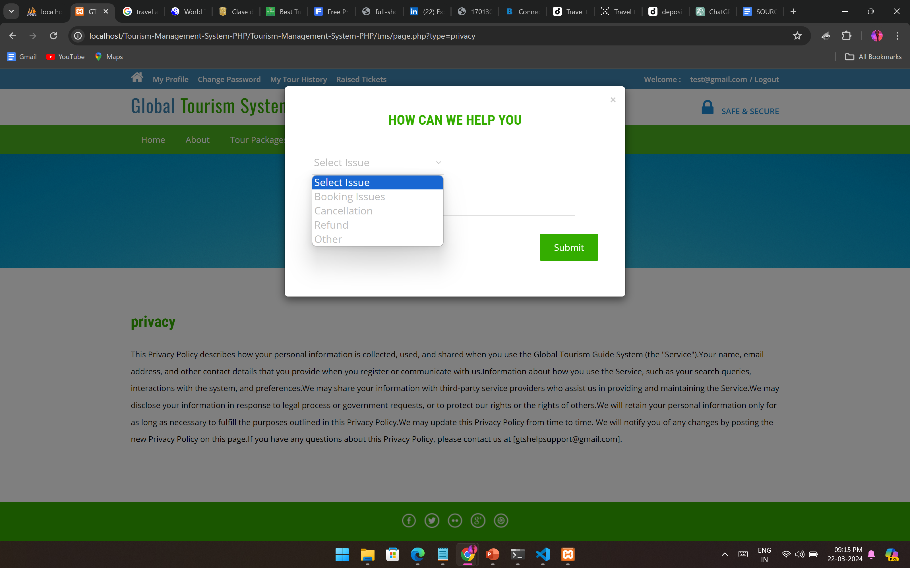
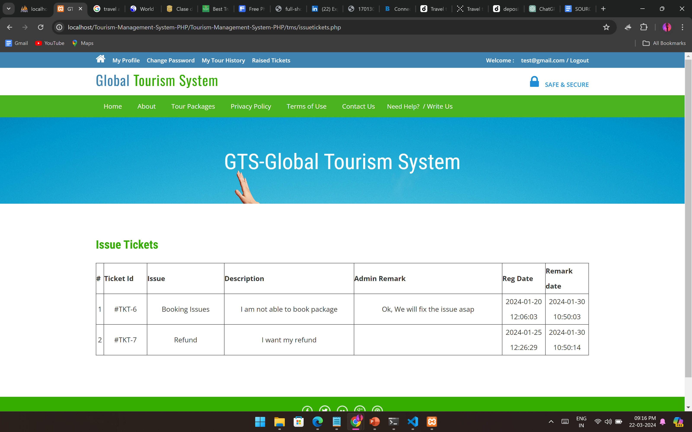
IMPLEMENTATION

Slide 19
RESULTS & FUTURE STEPS
The implementation of an intelligent tourist guide represents a significant advancement in the travel industry.
Leveraging technologies like artificial intelligence and machine learning, it offers personalized recommendations, real-time information, and seamless navigation, enhancing the overall tourist experience.

Slide 20
CONCLUSION
A Comprehensive Guide to Global Tourism and Cultural Navigation" represents a significant milestone in the realm of cultural exploration and travel. Throughout this project, we have endeavored to provide travelers with a comprehensive resource that not only facilitates their journey through diverse cultural landscapes but also fosters deeper understanding, appreciation, and respect for the world's rich tapestry of cultures.

Slide 21
REFERENCES
International Journal for Innovative Research in Science & Technology Tourist guide for Tamil Nadu by P.K. Jithin, M. Vishnuram, P. Prasath, J.T. Thirukrishna, 2018.
Smart travel guide by Dadape Jinendra R, Jadhav Bhagyashri R, Gaidhani Pranav V, Vyavahare Seema U, AchaliyaParag N, 2012.
Iguide – Intelligent tour guiding system by T.G.I. Bingun a, C.M. Palliyaguru b, V.M.P. Godakandage c, K.K.A.W. Madhubhashana d, S.A.U.S. Samaratunge e, T.D. Perera, 2017.
Intelligent Tourist Information System by Krzysztof Jele?, 2008.
Android Based Tourist Guide System by Prof. S.S. Pawar, Pooja Chavhan, Arti Lohar, Ashwini Kadam and Priyanka Ranjane, 2016.

Slide 22
THANK YOU !

